Slide 1
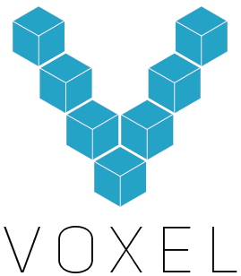

Slide 2
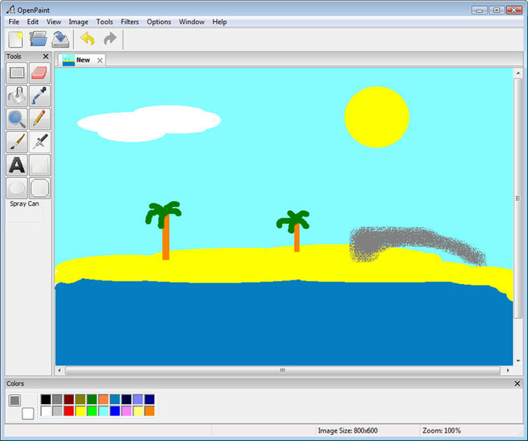
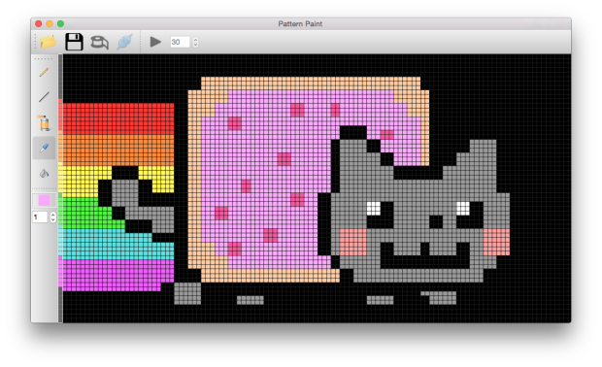
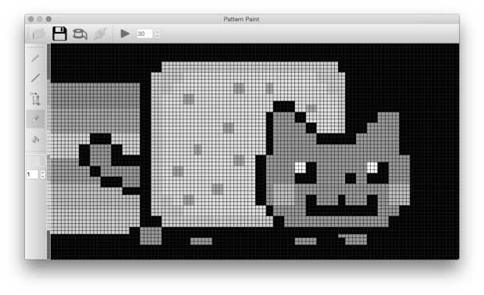
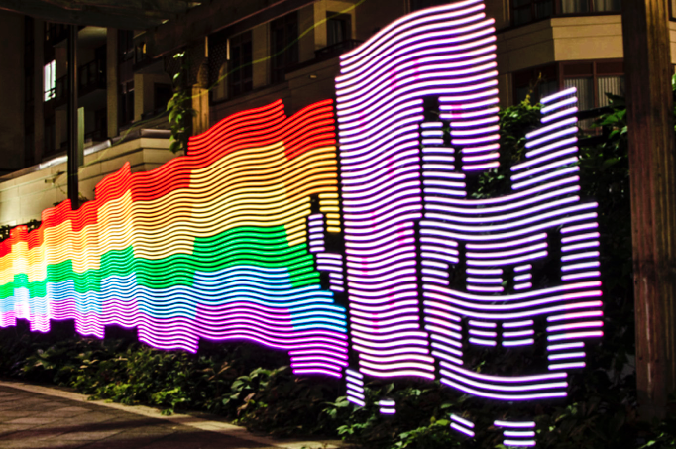
Light Painting

Slide 3
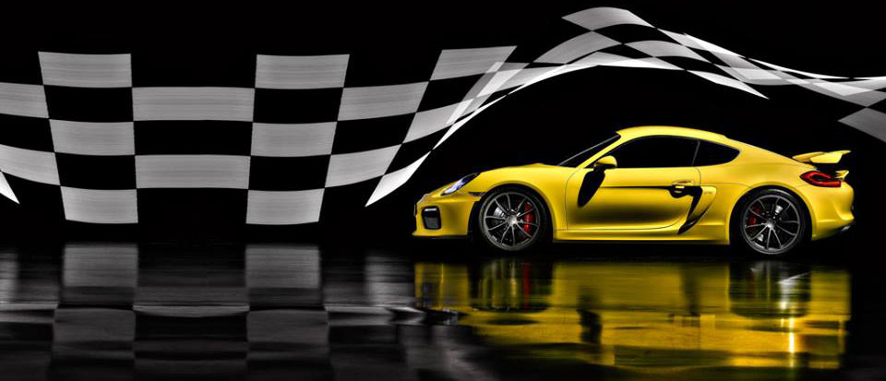
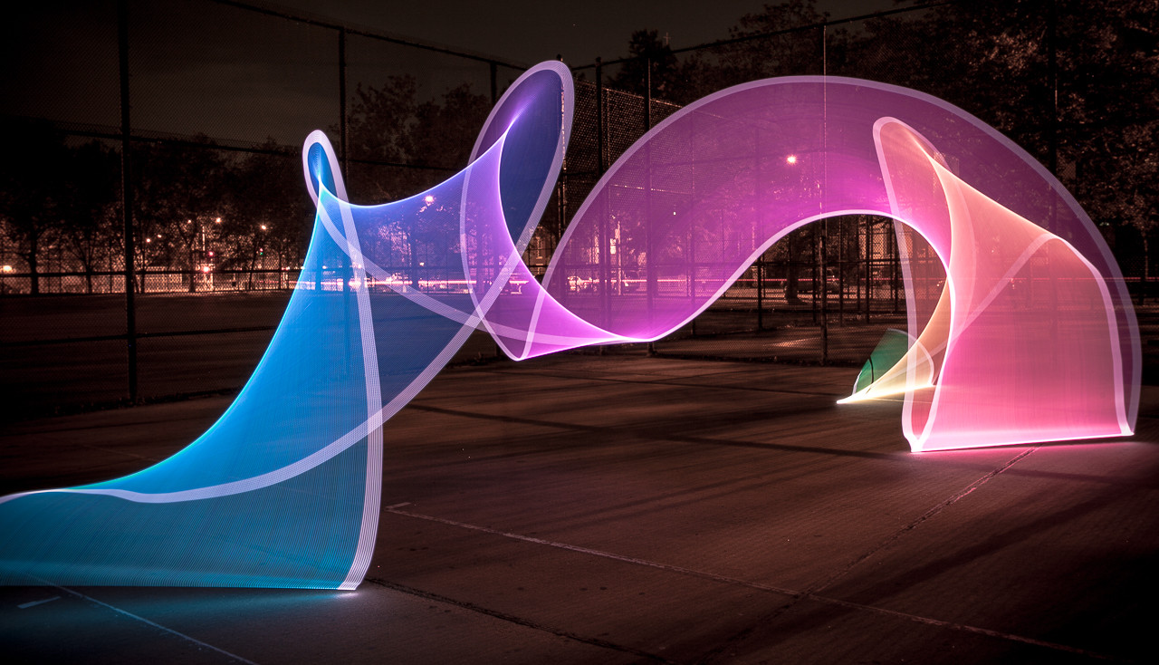
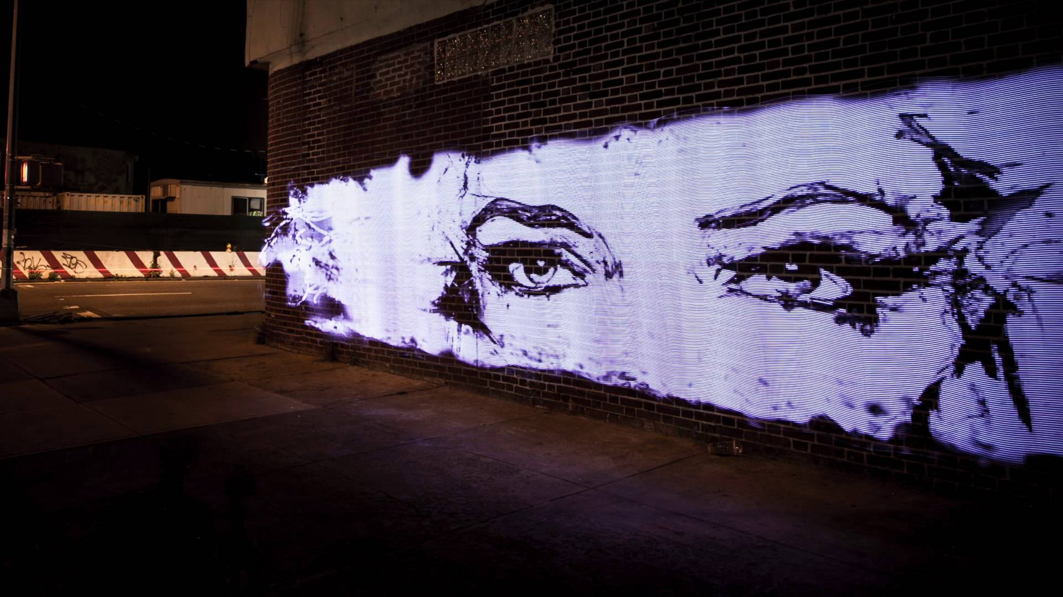
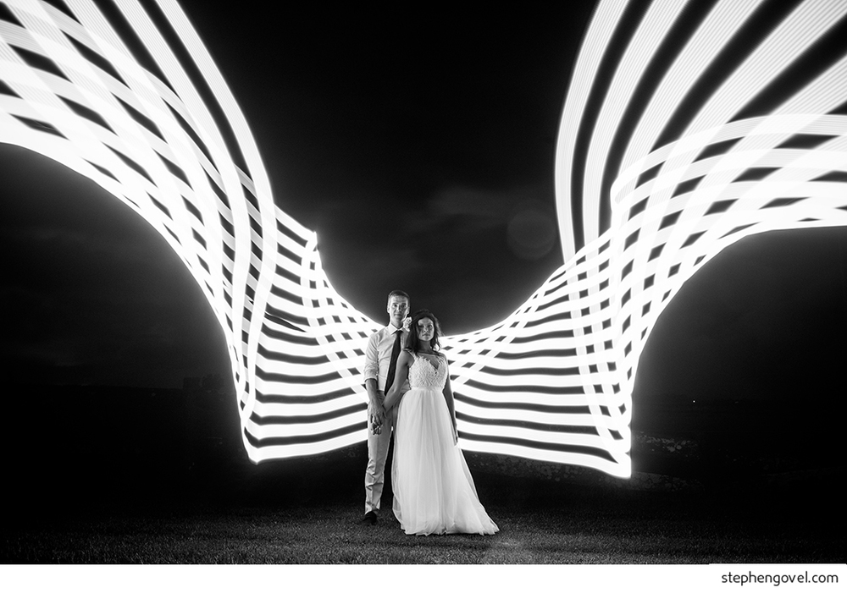
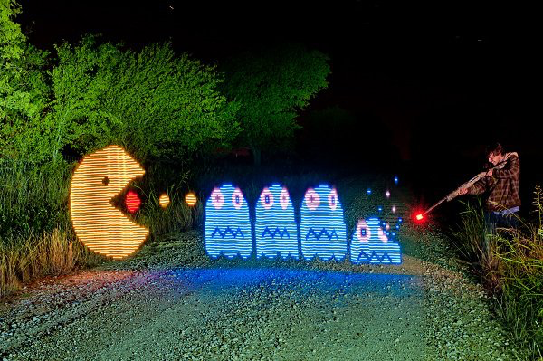
A New Dimension of Creativity

Slide 4
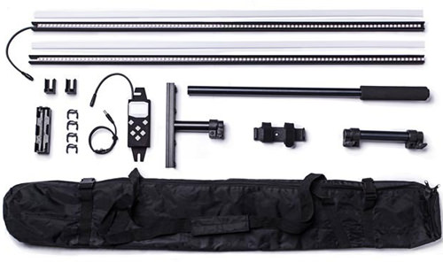
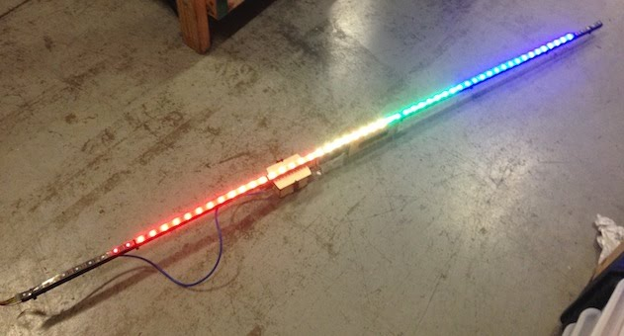
Existing Tools
DIY
PixelStick
Hours to Make or Setup
Pages of Documentation
Cumbersome User Interface

Slide 5
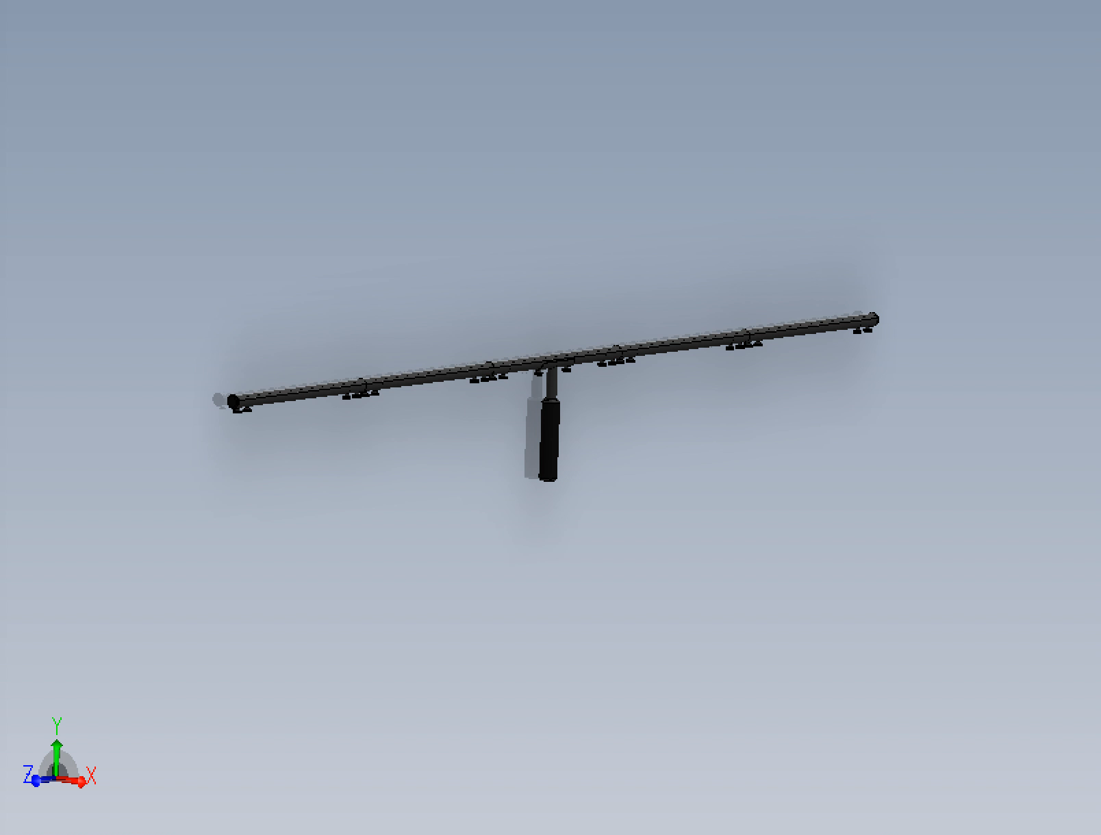
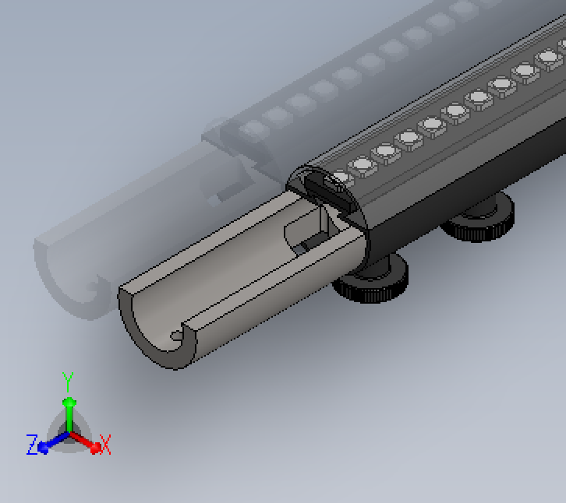
Voxel Prototype B

Slide 6
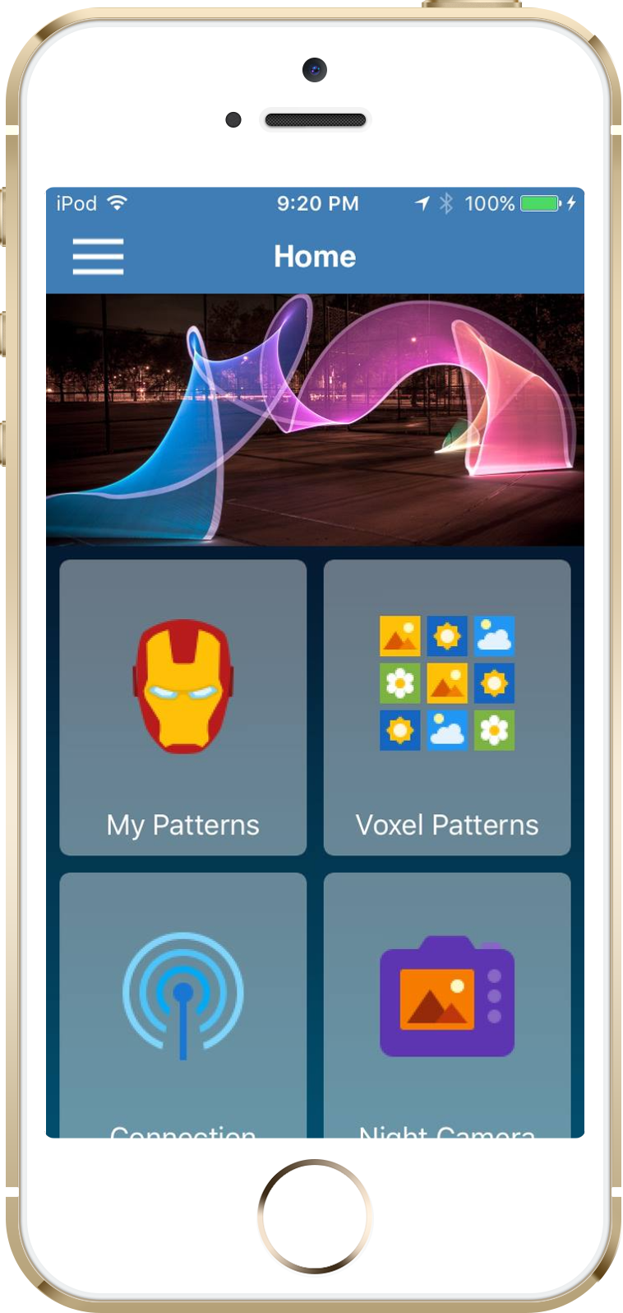




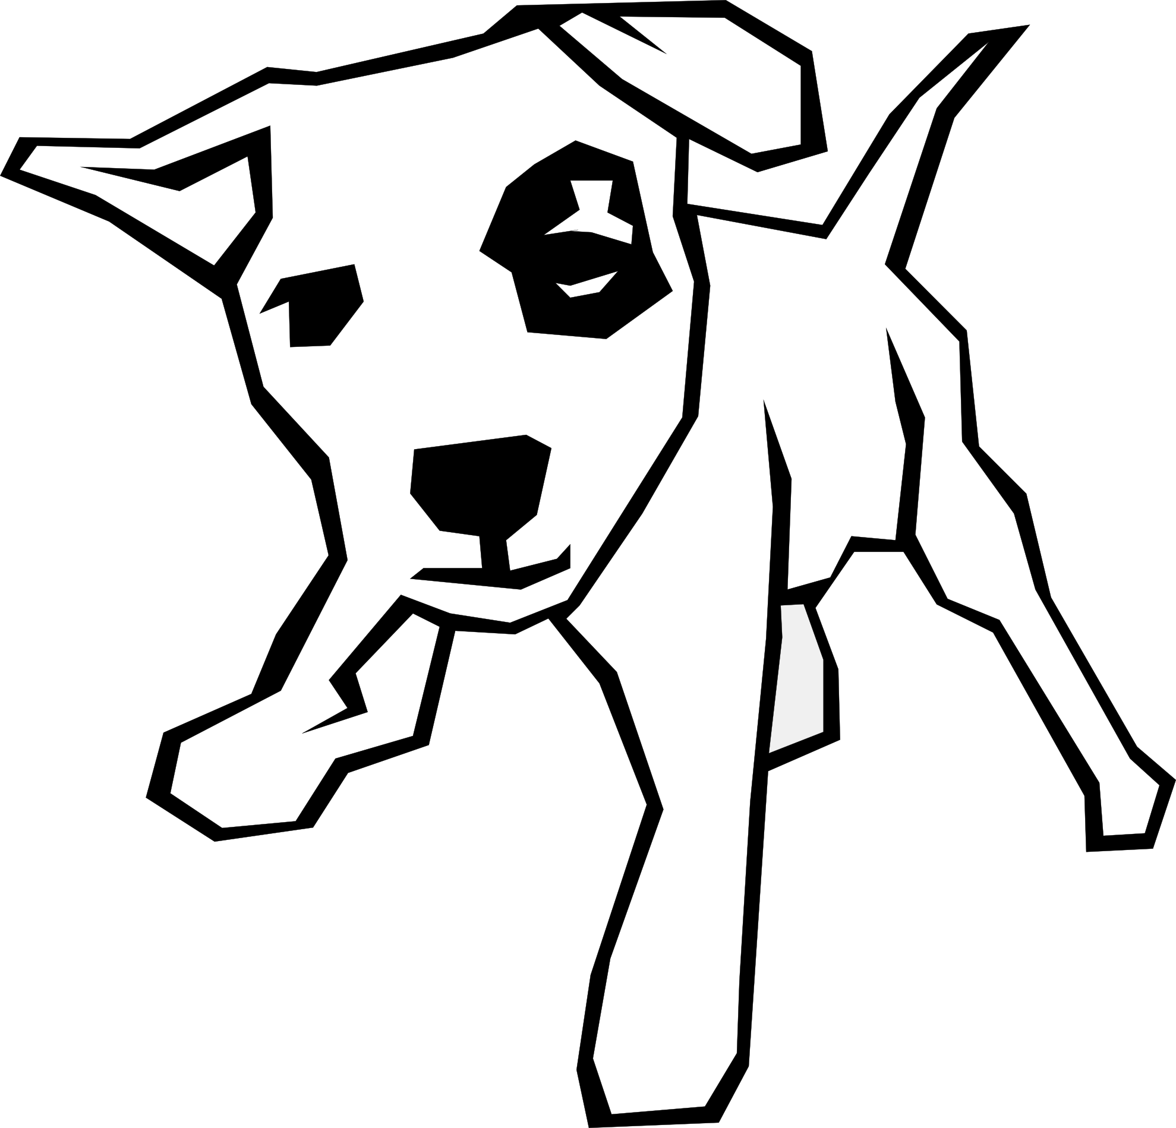

Powerful Mobile Software
(iOS 9.0)
Wifi connection
Quality
Designs
Auto image processing
In app image creation
Built-in
long exposure
camera

Slide 7
What’s the market?
All Camera Lighting
$910m*
*estimate based on extrapolation
of German statistics to world gdp
2,171 backers pledged $628,417 for PixelStick on Kickstarter
Phase 3
Sensors & accessories
$50m
LED lighting
$80m
Phase 2
art & 3d model marketplace
$20m
Phase 1
Simple light painting
$9.5m
Notes:
Entire market extrapolated from Germany 2012 stats
Phase 1 size estimated using comparative size of r/photography vs. r/lightpainting.

Slide 8
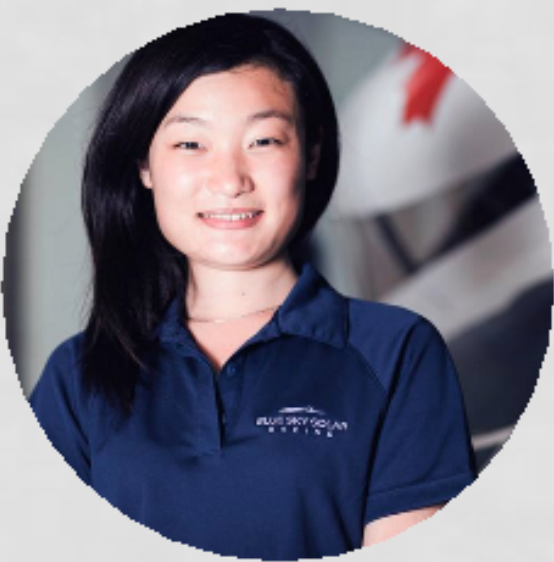
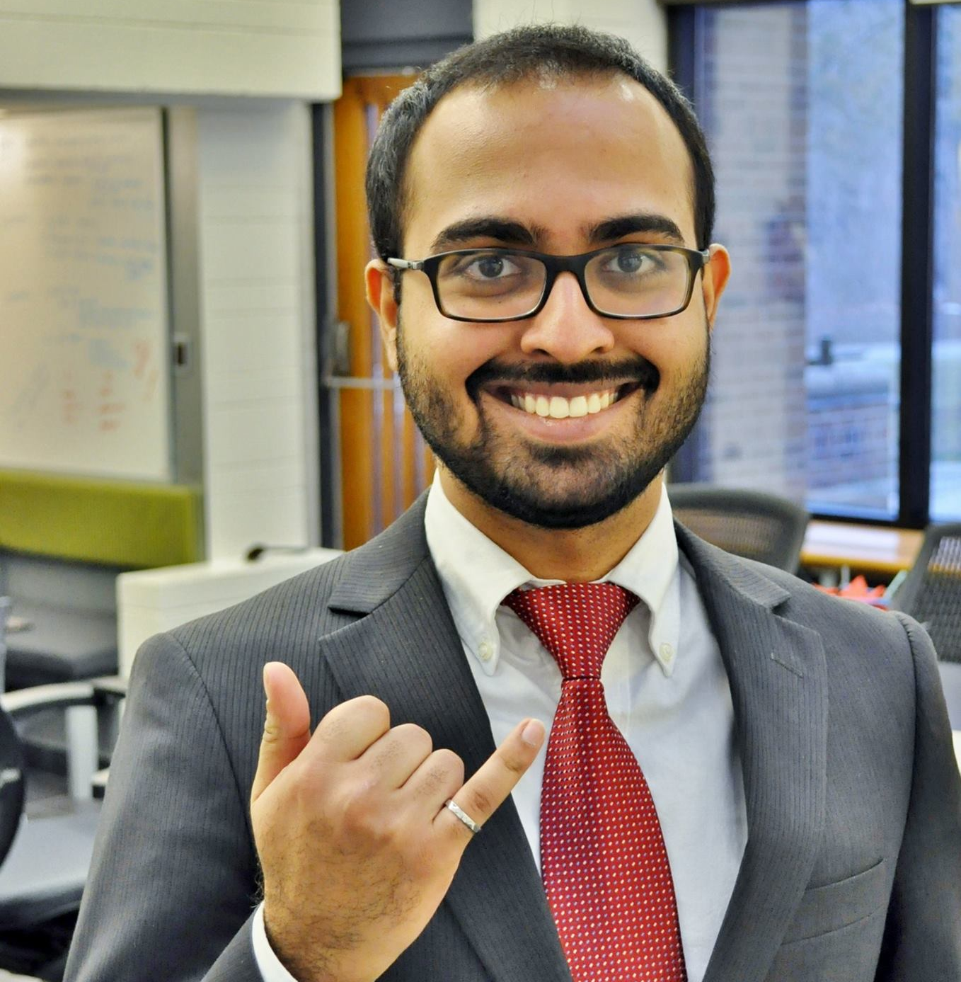


Team
Maria Xie
Lead Electrical
U of T EE 17
SciCan R&D
Blue Sky Solar EE Lead
Chaitanya Dogra Lead Mechanical
UW Tron 16
Structur3D Printing
Wescast Industries
Si Te Feng
Lead Software
UW Tron 17
Pebble
Clearpath Robotics
Tiange Li
Business Development
U of T Neuroscience 17
Toronto Rehab R&D

Slide 9
Customizable Hardware
Affordable
Automatic Image Processing
Simple Custom Artworks
Preloaded LED Patterns
Portable

